Slide 1
Unit 6
Inheritance

Slide 2
Inheritance
Information known in one part of a program is often needed and used in another part.
When information is passed among program components implicitly, it is called inheritance. Inheritance is the receiving in one program component of properties or characteristics of another component according to a special relationship that exists between the two components.
An early form of inheritance is found in the scope rules for block-structured data. Names used in an inner block may be inherited from the outer block. For example, consider
{int i, j;
{float j, k;
k = i + j; }
}

Slide 3
Inheritance
In k = i + j, both j and k are local float variables declared in the current block. However, i is inherited form the outer block, and the declaration of int j is blocked from being inherited into the inner block due to the redefinition of j as a float variable.
Although scope rules in languages like C are a form of inheritance, the term is more often used to refer to the passing of data and functions between independent modules of a program. The C++ class is one such example.
If a relationship between Class A and Class B is established, written A ⇒ B, then certain objects within Class A will be implicitly inherited and may be used within class B. if a certain Object X is declared within Class A and is not redefined in Class B, then any reference to Object X within Class B actually refers to Object X of Class A.

Slide 4
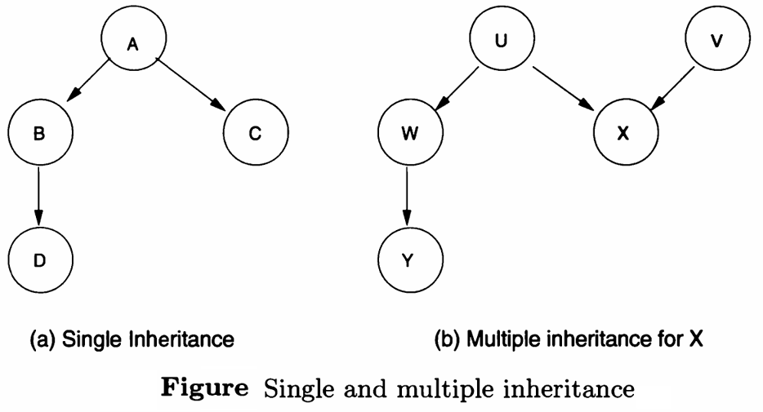
Inheritance
If we have A ⇒ B, we say that A is the parent class or superclass and B is the dependent, child, or subclass class. A is B’s immediate ancestor.

Slide 5
Inheritance
In the figure (a) above, A is the ancestor of both B and C, B and C are siblings, B and C are immediate descendants of A, and D is a descendant of A. If a class can only have a single parent (figure (a)), we say that it has single inheritance. If a class can have multiple parents (figure (b)), we say that is has multiple inheritance.
C++, but not Java, allows for multiple inheritance.

Slide 6
Derived Classes
Classes typically have a part that gets inherited by another class and a part that is used internally and hidden from outside exposure.
A derived class is a class that is constructed from a base class or an existing class. It has a tendency to acquire some of the methods and properties of a base class. Derived class is also known as a subclass or child class.
Inheritance occurs via the use of derived classes. In a derived class, only the inherited names from the base class are made visible to users of that class.
In a derived class, only the inherited names from the base class are added to the local name space for the derived class, and only the public ones are made visible to users of that class.

Slide 7
Derived Classes
In copy-based approach toward inheritance, each instance of a class has its own data storage consisting of data objects making up objects of the class as well as pointer to all methods defined for objects of that class.
In delegation-based approach toward inheritance, any object of a derived class will use the data storage of the base class. Inherited properties are not duplication in the derived class. This model requires a form of data sharing so that changes to the base object may cause changes to the derived object.

Slide 8
Abstract Classes
There are times when we would like our class definition to be simply a template for a class and not allow objects to be declared with that definition.
Abstract class is a class that can not be initiated by itself, it needs to be subclassed by another class to use its properties.
In Java, an abstract class is declared using the “abstract” keyword in its class definition. Abstract class in Java may have both abstract and non-abstract methods (methods with bodies).
In C++, an abstract class contains at least one pure virtual function. You declare a pure virtual function by using a pure specifier (= 0) in the declaration of a virtual member function in the class declaration.

Slide 9
Objects and Messages
Specific objects are created for each class definition by invoking creation methods within the class definition. The process of creating objects is called instantiation. An object is also called instance of the class.
The association of a method with an object is called a message. A message is a request to an object to invoke one of its methods. A message therefore contains: name of the method and arguments of the method. Invocation of a method is just a reaction caused by receipt of a message. A method is associated with a class. An object invokes a method as a reaction to receipt of a message.

Slide 10
Polymorphism
Polymorphism means the ability of a single operator or subprogram name to refer to any number of function definitions depending on the data types of the arguments and results.
There are two types of polymorphisms: compile-time and runtime.
Compile-time Polymorphism:
It is also known as static polymorphism. This type of polymorphism is achieved by function overloading, operator overloading and templates.
In function overloading, multiple functions can have the same name but different parameter lists. The compiler will decide which function to call based on the number and types of arguments passed to the function.

Slide 11
Polymorphism
In operator overloading, operators such as +, -, *, etc. can be given additional meanings when applied to user-defined data types.
Template is a powerful feature that allows us to write generic functions and classes. A template is a blueprint for creating a family of functions or classes.
Runtime Polymorphism:
It is also known as dynamic method dispatch. It is a process in which a function call to the overridden method is resolved at Runtime. This type of polymorphism is achieved by method overriding.
Method overriding occurs when a derived class has a definition for one of the member functions of the base class. That base function is said to be overridden.

